Slide 1


Slide 2


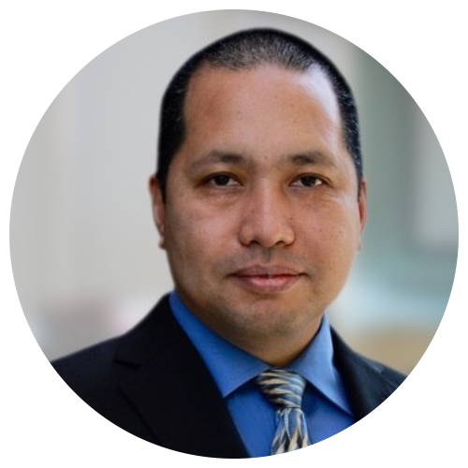
Casey Mullins
Kim
Young
Rafael Encarnacion

Slide 3


Slide 4

Casey
Mullins
INTRO
Ransomware Definition
Darkside Group (?)

Slide 5


Intro

Slide 6
What is Ransomware?

Slide 7
Darkside Group

Slide 8
Kim
Young
Background
Decisions
Impacts

Slide 9
Background
The Colonial Pipeline is the largest in the US
Darkside is a criminal hacker group, thought to be based in eastern Europe

Slide 10
Decisions
Shutting Down the Pipeline…
the company didn’t know how much access the hackers might gain, maintaining operational control of the pipeline was paramount
to prevent hackers from migrating to the pipeline control system, Colonial decided a complete shutdown was necessary
Paying the Ransom…
wanted to get the pipeline back online as quickly as possible
wanted to keep the situation confidential

Slide 11
Impacts
Panic buying
Inventory reduction
Opportunity cost
Expectation management
Increased regulation and inspection

Slide 12
Rafael Encarnacion
Phishing
RDP Abuse
Vulnerabilities

Slide 13
Phishing
Email Scanning
Sandboxing
Awareness Training
Endpoint Protection

Slide 14
RDP Abuse
Stop Using RDP
See above
Seriously, use something else!
Add MFA

Slide 15
Vulnerabilities
Patching
Vulnerability Scanning/Management
Layered detection for Zero-Day Attacks
Low Privilege

